Slide 1
Social-psychological factors of personality traumatisation
PhD Anna Krutolevich

Slide 2
Introduction
This course is a part of Psychotraumatology
Psychotraumatology is the study of natural and man-made trauma (from the natural trauma of the accidental and the geophysical to the horrors of human inadvertent or volitional cruelty), the social and psychobiological effects thereof, and the predictive-preventive-interventionist parameters which evolve from that study (Donovan)

Slide 3
Historical aspects of psychotraumatology

Slide 4
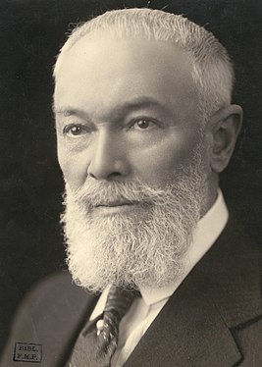
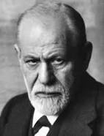
Historical aspects of psychotraumatology
First publications on the topic of traumatisation from Pierre-Marie-Félix Janet («Dissociation»), Pierre Janet and Sigmund Freud investigated the aetiology of hysteria
Pierre Janet
Sigmund Freud

Slide 5
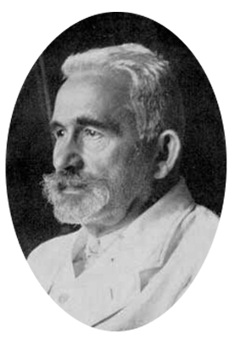
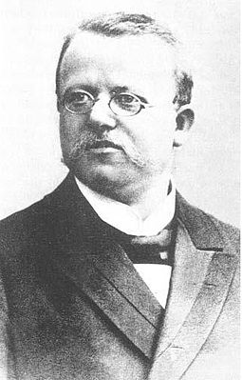
Historical aspects of psychotraumatology
Emil Kraepelin – classification of mental disorders,
Hermann Oppenheim («Traumatic neurosis»)
Emil Kraepelin
Hermann Oppenheim

Slide 6
Railway Liverpool

Slide 8
Historical aspects of psychotraumatology
In the 19th century – industrialization and urbanization in Europe (Great Britain in the 1769 was invented a cotton-machine), and than began a railway construction (since 1829 in Great Britain and USA, since 1840- in Germany)
In the mid-19th century, surgeon John Eric Erichsen coined the term «railway spine» to describe the symptoms he observed among people who survived or witnessed train accidents
in 1866 John Eric Erichsen developed the influential hypotheses that psychological symptoms after railway accidents were caused by a concussion of the spine followed by „molecular changes” in the spinal cord(„railway spine syndrome”).

Slide 9
A Really «railway-spine» story
«disability pension neurosis» : submitting a request at a pension after railway accidents
Claims for compensation for damage and receipt of a pension for railway workers were discussed

Slide 10
The shell shock & soldier's heart & …..
American Civil War surgeon Jacob Mendez Da Costa described similar symptoms among soldiers he treated on the battlefield—a condition he called soldier's heart.
British military psychiatrist Charles Samuel Myers referred to the shell shock experienced by World War I soldiers after they returned from combat.

Slide 12
World War I and II
In World War I and II, up to 10 % of the soldiers were exempted from further service because they suffered from nervous breakdowns caused by the experience of war („shell shock”).

Slide 13
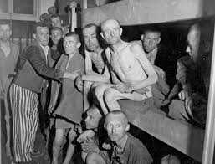
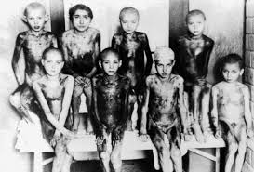
Victims of World War II,

Slide 14
Historical aspects of psychotraumatology
Diagnostic terms applied to symptoms have included Soldier's Heart, Battle Fatigue, War Neurosis, Da Costa's Syndrome, Tunnel Disease, Railway Spine Disorder, Shell Shock, Gross Stress Reaction, Adjustment Reaction of Adult Life, Transient Situational Disturbance,Traumatic Neurosis, Post-Vietnam Syndrome, Rape Trauma Syndrome, Child Abuse Syndrome, and Battered Wife Syndrome (Everly, 1995; Meichenbaum, 1994).
The Diagnostic and Statistical Manual of Mental Disorders-Third Edition (DSM-III) first recognized Posttraumatic Stress Disorder (PTSD) as a distinct diagnostic entity in 1980 (APA, 1980).
It was categorized as an anxiety disorder because of the presence of persistent anxiety, hypervigilance, exaggerated startle response, and phobic-like avoidance behaviors (Meichenbaum, 1994).

Slide 15
Historical aspects of psychotraumatology
Insights into the psychological long-term effects of Nazi Germany's concentration camps, the political activities of the Vietnam Veterans, and evidence from clinical studies resulted in the introduction of the newly defined diagnosis „Post-traumatic Stress Disorder” into DSM-III in 1980.
In the past few years, several aspects of this diagnostic concept were legitimately criticized. Nevertheless, the official introduction of the diagnosis led to the acknowledgement of personal suffering and to the development of specific and efficacious therapies

Slide 16
Traumatic life events
Traumatic events are typically unexpected and uncontrollable.
They may overwhelm an individual's sense of safety and security and leave a person feeling vulnerable and insecure in their environment.
Natural disorder, fire or explosion, transportation accident, physical assault, sexual assault, other unwanted or uncomfortable sexual experience

Slide 17
Type I (short) | Type II (longtime)
motor vehicle accidents (MVA), boat, train, airplane accidents, fires, and explosions | natural and technological disasters
involve bombings, rape, hostage situations, assault and battery, robbery, and industrial accidents | intentional human design include combat, child sexual abuse, battered syndrome (i.e., spousal abuse), being taken as political prisoner or prisoner of war (POW), and Holocaust victimization

Slide 18
Type I Life Events
Events that are abrupt, often lasting a few minutes and as long as a few hours can be referred to as short-term or Type I traumatic events (Terr, 1991).
Included within this category are natural and accidental disasters as well as deliberately caused human-made disasters.
Natural disasters include events such as hurricanes, floods, tornadoes, earthquakes, volcanic eruptions, and avalanches. Accidental disasters may include motor vehicle accidents (MVA), boat, train, airplane accidents, fires, and explosions. Deliberately caused human-made disasters (i.e., intentional human design or IHD) involve bombings, rape, hostage situations, assault and battery, robbery, and industrial accidents.

Slide 19
Type II Life Events
Sustained and repeated traumatic events (or Type II traumatic events) typically involve chronic, repeated, and ongoing exposure. Examples include natural and technological disasters such as chronic illness, nuclear accidents, and toxic spills.
Events resulting from intentional human design include combat, child sexual abuse, battered syndrome (i.e., spousal abuse), being taken as political prisoner or prisoner of war (POW), and Holocaust victimization.
It is important to consider that research indicates that, despite the heterogeneity of traumatic events, individuals who directly or vicariously experience such events show similar profiles of psychopathology including chronic PTSD and commonly observed comorbid disorders such as depression, generalized anxiety disorder, and substance abuse (Solomon, Gerrity, & Muff, 1992).

Slide 20
comorbid disorders
depression, generalized anxiety disorder, and substance abuse, personality disorders
(41% criminal victims) sexual dysfunction
(27% criminal victims) obsessive-compulsive symptoms
(82% criminal victims) depression
(18% criminal victims) phobias

Slide 21
Life Prevalence
7.8% (Breslau, Kessler & Chilcoat, et al. 1998), 5% men и 10% women
Women – 2.9%, men– 0.9% (Alonso, Angermeyer, Bernert, Bruffaerts et al. (2004)
Medical workers (paramedics) 20-30%
Soldiers (30-50%)
Rape, physical, sexual assault

Slide 22
PTSD
Differential diagnosis
Current Diagnostic Criteria and Other Considerations

Slide 23
Posttraumatic Stress Disorder
PTSD may develop following exposure to an extremely threatening or horrific event or series of events (ICD-11)
Arises as a delayed or protracted response to a stressful event or situation (of either brief or long duration) of an exceptionally threatening or catastrophic nature, which is likely to cause pervasive distress in almost anyone (ICD-10)

Slide 24
Criterion A ICD-11 Traumatic life events
Type I (short) | Type II (longtime)
motor vehicle accidents (MVA), boat, train, airplane accidents, fires, and explosions | natural and technological disasters
involve bombings, rape, hostage situations, assault and battery, robbery, and industrial accidents | intentional human design include combat, child sexual abuse, battered syndrome (i.e., spousal abuse), being taken as political prisoner or prisoner of war (POW), and Holocaust victimization

Slide 25
Which of events LEC-5

Slide 26
LEC-5

Slide 27
PTSD Symptoms ICD-11
b) re-experiencing the traumatic event or events in the present in the form of vivid intrusive memories, flashbacks, or nightmares. Re-experiencing may occur via one or multiple sensory modalities and is typically accompanied by strong or overwhelming emotions, particularly fear or horror, and strong physical sensations;
c) avoidance of thoughts and memories of the event or events, or avoidance of activities, situations, or people reminiscent of the event(s);
d) persistent perceptions of heightened current threat, for example as indicated by hypervigilance or an enhanced startle reaction to stimuli such as unexpected noises.
The symptoms persist for at least several weeks and cause significant impairment in personal, family, social, educational, occupational or other important areas of functioning.

Slide 28
PTSD Symptoms ICD-10
Typical features include episodes of repeated reliving of the trauma in intrusive memories ("flashbacks"), dreams or nightmares, occurring against the persisting background of a sense of "numbness" and emotional blunting, detachment from other people, unresponsiveness to surroundings, anhedonia, and avoidance of activities and situations reminiscent of the trauma. There is usually a state of autonomic hyperarousal with hypervigilance, an enhanced startle reaction, and insomnia. Anxiety and depression are commonly associated with the above symptoms and signs, and suicidal ideation is not infrequent.

Slide 29
Self-learning (homework) IES-R

Slide 30
Self-learning (homework)

Slide 31
Kessler, 1995 (USA) (15 - 65 years old , PTSD life prevalence)
Sexual assault (5.5) 55,5%
sexual harassment (7.5) 19,3%
Soldiers, combat or exposure to a war-zone (3.2) 38,8%
Assault with a weapon (12.9) 17,2%
Physical assault (9.0) 11,5%
Accidents (car, boat, train wreck) (19.4) 7%
To be a witness of accidents or assault (25.0) 7%
Sexual or physical assault in childhood (4.0) 35,4%
Fire, explosion and natural disaster (17.1) 4,5%
Parental neglect (2.7) 21,8%

Slide 32
PTSD Checklist 5 (PCL-5)

Slide 33
PTSD Checklist 5 (PCL-5)

Slide 34
PTSD Checklist 5 (PCL-5)

Slide 35
Acute stress reaction
Acute stress reaction refers to the development of transient emotional, somatic, cognitive, or behavioral symptoms as a result of exposure to an event or situation (either short- or long-lasting) of an extremely threatening or horrific nature (e.g., natural or human-made disasters, combat, serious accidents, sexual violence, assault).
Symptoms may include autonomic signs of anxiety (e.g., tachycardia, sweating, flushing), being in a daze, confusion, sadness, anxiety, anger, despair, overactivity, inactivity, social withdrawal, or stupor.
usually begins to subside within a few days after the event or following removal from the threatening situation.

Slide 36
QE84 Acute stress reaction ICD-11 vs. ICD-10
24 Factors influencing health status or contact with health services
Factors influencing health status
Problems associated with harmful or traumatic events
QE84 Acute stress reaction
ICD-10
V Mental and behavioral disorders
F43 Reaction to severe stress, and adjustment disorders
F43.0 Acute stress reaction

Slide 37
6B41 Complex post traumatic stress disorder
ICD-11
Complex post traumatic stress disorder is a disorder that may develop following exposure to an event or series of events of an extremely threatening or horrific nature, most commonly prolonged or repetitive events from which escape is difficult or impossible (e.g. torture, slavery, genocide campaigns, prolonged domestic violence, repeated childhood sexual or physical abuse).
Complex PTSD is characterised by severe and persistent 1) problems in affect regulation; 2) beliefs about oneself as diminished, defeated or worthless, accompanied by feelings of shame, guilt or failure related to the traumatic event; and 3) difficulties in sustaining relationships and in feeling close to others.
ICD-10
Disorders of adult personality and behaviour (F60-F69)

Slide 38
6B42 Prolonged grief disorder
ICD-11
Prolonged grief disorder is a disturbance in which, following the death of a partner, parent, child, or other person close to the bereaved, there is persistent and pervasive grief response characterised by longing for the deceased or persistent preoccupation with the deceased accompanied by intense emotional pain (e.g. sadness, guilt, anger, denial, blame, difficulty accepting the death, feeling one has lost a part of one’s self, an inability to experience positive mood, emotional numbness, difficulty in engaging with social or other activities). The grief response has persisted for an atypically long period of time following the loss (more than 6 months at a minimum) and clearly exceeds expected social, cultural or religious norms for the individual’s culture and context.
ICD-10

Slide 39
6B43 Adjustment disorder
ICD-11
Adjustment disorder is a maladaptive reaction to an identifiable psychosocial stressor or multiple stressors (e.g. divorce, illness or disability, socio-economic problems, conflicts at home or work) that usually emerges within a month of the stressor. The disorder is characterised by preoccupation with the stressor or its consequences, including excessive worry, recurrent and distressing thoughts about the stressor, or constant rumination about its implications, as well as by failure to adapt to the stressor that causes significant impairment in personal, family, social, educational, occupational or other important areas of functioning.
ICD-10
Adjustment disorder (F43.2) is a part of neurotic, stress-related and somatoform disorders (F40-F48)

Slide 40
Dissociative disorders 6B60
ICD-11
Dissociative disorders
Dissociative disorders are characterised by involuntary disruption or discontinuity in the normal integration of one or more of the following: identity, sensations, perceptions, affects, thoughts, memories, control over bodily movements, or behaviour. Disruption or discontinuity may be complete, but is more commonly partial, and can vary from day to day or even from hour to hour.
Dissociative symptoms in dissociative disorders are sufficiently severe to result in significant impairment in personal, family, social, educational, occupational or other important areas of functioning.
Dissociative [conversion] disorders (F 44) – are a part of Neurotic, stress-related and somatoform disorders (F40-F48)

Slide 41
Thank you very much!

